Slide 1
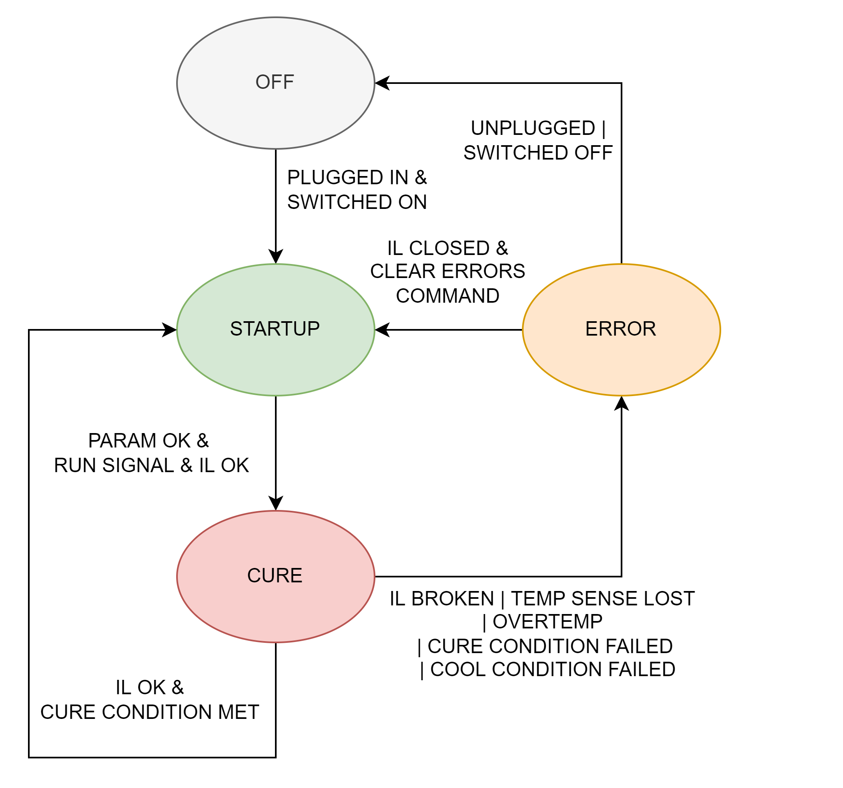
Oven Code Review
Code Purpose
Accept User Input from buttons
Control OCE Outputs, Measure Inputs
Manage Errors and Unexpected Inputs

Slide 2
List of Issues
Issue Name | Description | Proposed Fix
DataSave Overwrite | DataSave overwrites previous file | Check if the file exists, increment filename if so, display filename on screen
Fix padding | Numbers move around / poorly padded | Add a helper function to display the correct number and in the right position
Control off Screen | C leaves screen on Cure state | Pad number correctly
Therm. 7-9 deselect not working | Interesting | Weird wrapping stuff

Slide 3
List of Todos
Issue Name | Description | Proposed Fix
Thermistor Screen | Add thermistor screen with all values | Fix scrolling between screens during cure
Real time clock | Add the RTC to the file header | Use the Teensy RTC synced to the PC
Log process T | Log the average temperature | Add a column to the data file
Protect AUX | Protect AUX from on/off cycling | Add a deadtime to the AUX output to avoid repeated starts
EEPROM settings | Oven can save current settings | If the user wishes (control tab), save setup to EEPROM
Ambient Setpoint | Ambient may not match actual | Collect a few seconds of data to set the ambient
OVT / Setpoint Ctrl | Balance setpoint control with OVT | Improve handoff between to targets to prevent oscillation
Menu Issues | Back button goes all the way to the main menu | Fix timing issues (see diagram on startup slide) to properly catch button presses
Thermistor Select | Cursor starts on description text | Adjust offsets so it works better
Cure Menu Display | Add more resolution to time displays | Swap units / padding when t < 1 h, t:tt > 1 h

Slide 4
Safety Cases to Test
Case | Description | Expected Behaviour | Pass/Fail
Duct Disconnected | Duct is disconnected | No pitot tube, pressure switch wired NC | Fail
Oven Lid Open | Oven partially open | No ability to check without more IL routing | N/A, OoS
High Delta T | Thermistors not consistent | Check disabled to promote oven reliability, no response | Fail
Vacuum Leak | Leak, AUX on for full cure | Allow AUX to run for full cure
PCB Failure | Damage to PCB | Thermal fuse breaks IL after heater runaway | To Check

Slide 5
Big Questions
Logging file format - .csv
Might be neat to have something with headers

Slide 6
State 1: Startup

Slide 7
State 2: Cure

Slide 8
PID Control

Slide 9
State 3: Error

Slide 10
Function Description: driveHTR1()
Function operates on volatile variables to turn the heater output (that switches the SSR) on or off to generate a PWM signal at 60 Hz, duty cycle 0-100%

Slide 11
Oven Digital Twin

Slide 12
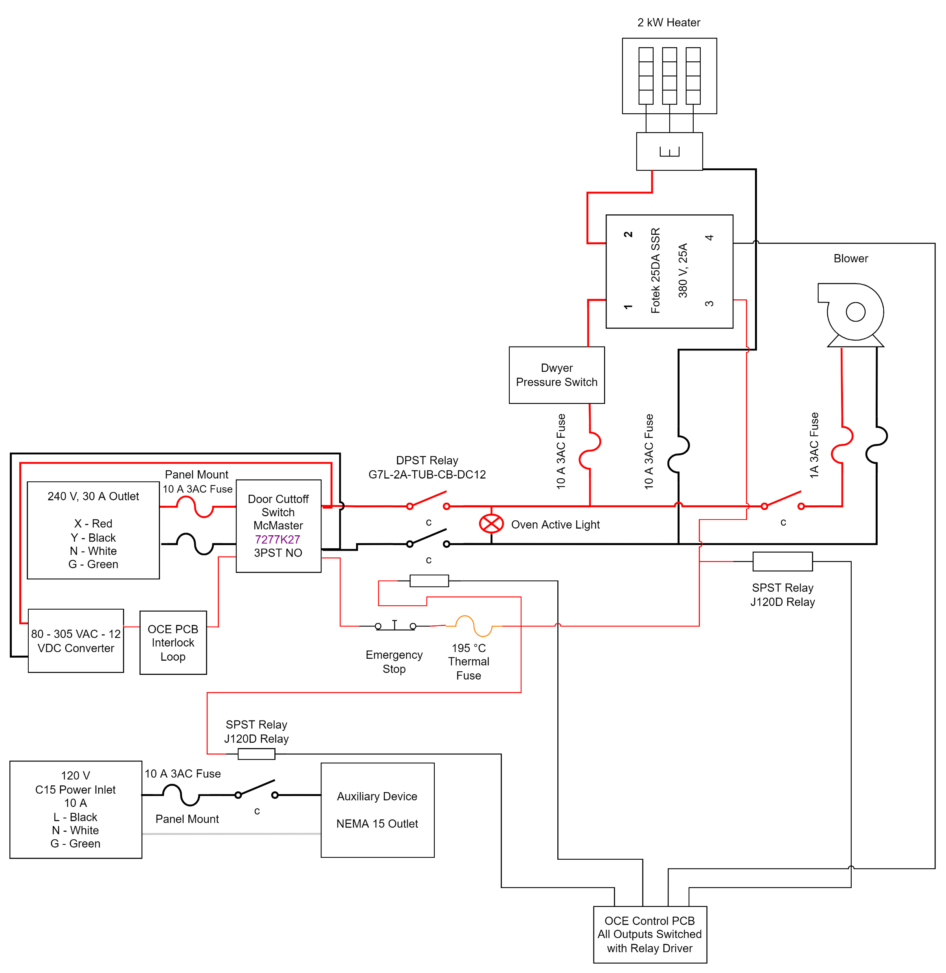
void setup()

